Slide 1
Work schedule.bat
ELEBC 2023 Jessy

Slide 2
Run02.bat
Use API to get the Youbike2.0_data from Taipei city in every 15 mins

Slide 3
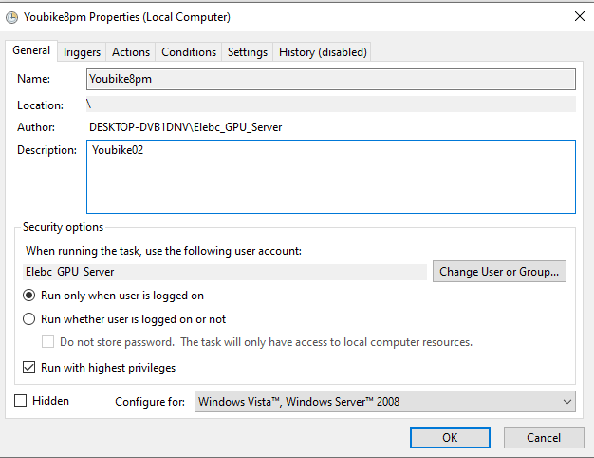
Run02.bat (1)

Slide 4
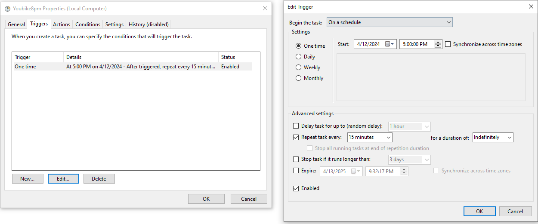
Run02.bat (2)

Slide 5
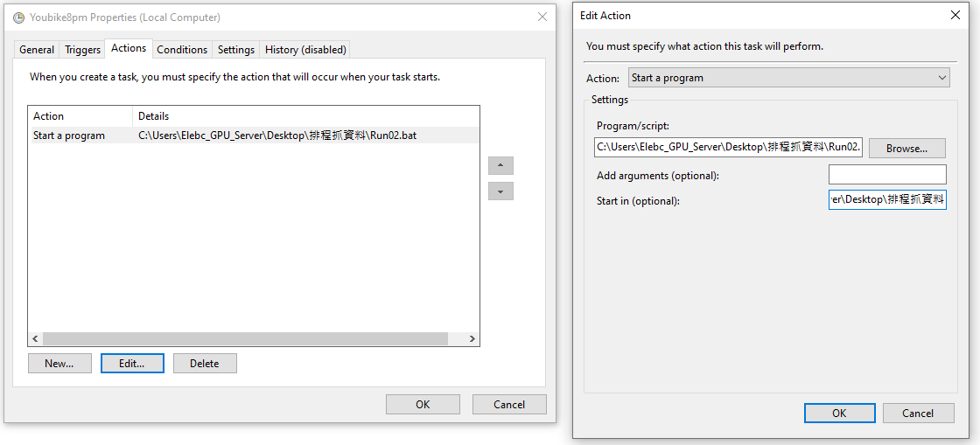
Run02.bat (3)
Start in C:\Users\Elebc_GPU_Server\Desktop\排程抓資料

Slide 6
Run03.bat
Combine the Youbike_15mins_data excels to merged data by DAY.
Select column [“bemp”].

Slide 7
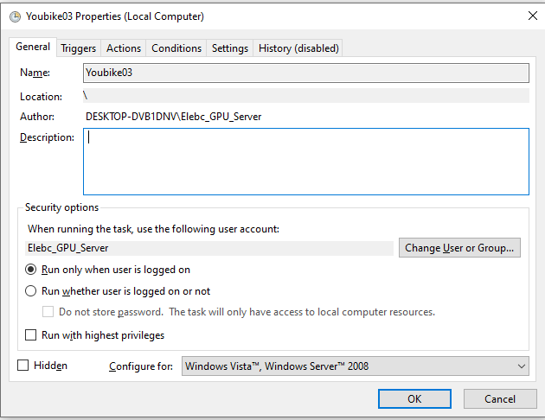
Run03.bat (1)

Slide 8
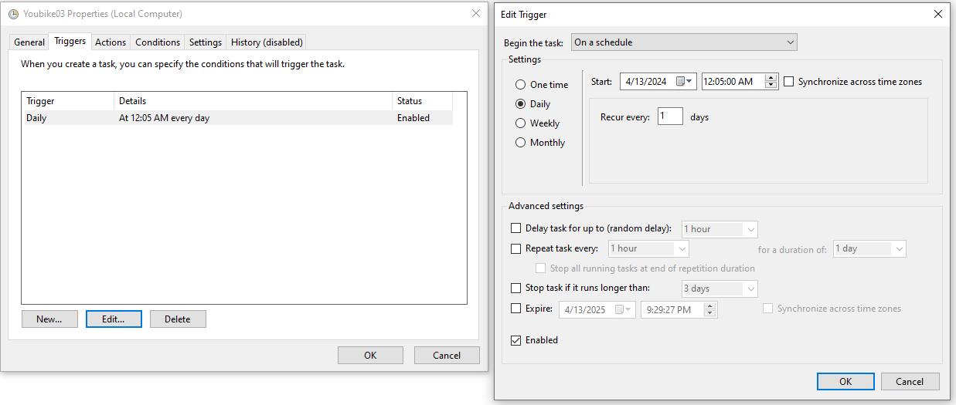
Run03.bat (2)

Slide 9
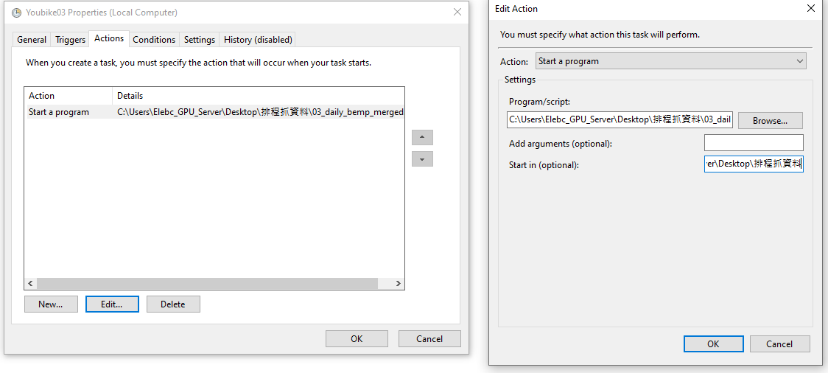
Run03.bat (3)
Start in: C:\Users\Elebc_GPU_Server\Desktop\排程抓資料

